Slide 1

INTELLIGENT DISTRIBUTION OF FRESH AGRICULTURAL PRODUCTS IN SMART CITIES
Internal Guide
Presented By:
Head of the Department
Mr.V.Chiranjeevi
(Assistant Professor)
K.Suvishal T. Laxmi Narayana
Dr.N.Srinivas Rao
(Associate Professor)

Slide 2
Introduction
• Rising demand for Fresh Agricultural Products (FAP) in smart cities.
• Efficient distribution is essential for maintaining product quality, reducing costs, and enhancing customer satisfaction.

Slide 3
Objectives
Primary Goals:
• Minimize distribution costs.
• Maximize customer satisfaction.
Secondary Goals:
• Improve distribution efficiency.
• Maintain product freshness through optimized logistics.

Slide 4
PROBLEM STATEMENT
The inefficient distribution of Fresh Agricultural Products leads to increased costs, delays and food wastage.
SOLUTION
Optimize the distribution of fresh agricultural products in smart cities.
Minimize transportation costs while maximizing customer satisfaction.

Slide 5
Existing System
Current Approach:
Uses genetic algorithms for optimizing logistics paths.
Applied in existing enterprises for reduced distribution costs and enhanced satisfaction.
Limitations:
Does not fully utilize intelligent distribution techniques.
Limited by time-varying conditions in logistics.

Slide 6
Proposed System
Innovations:
• Models distribution vehicle speed under varying weather and time conditions.
• Increasing customer satisfaction.
• Introduces an Improved Quantum-behaved Particle Swarm Optimization (IQPSO) algorithm for multi-objective optimization.

Slide 7
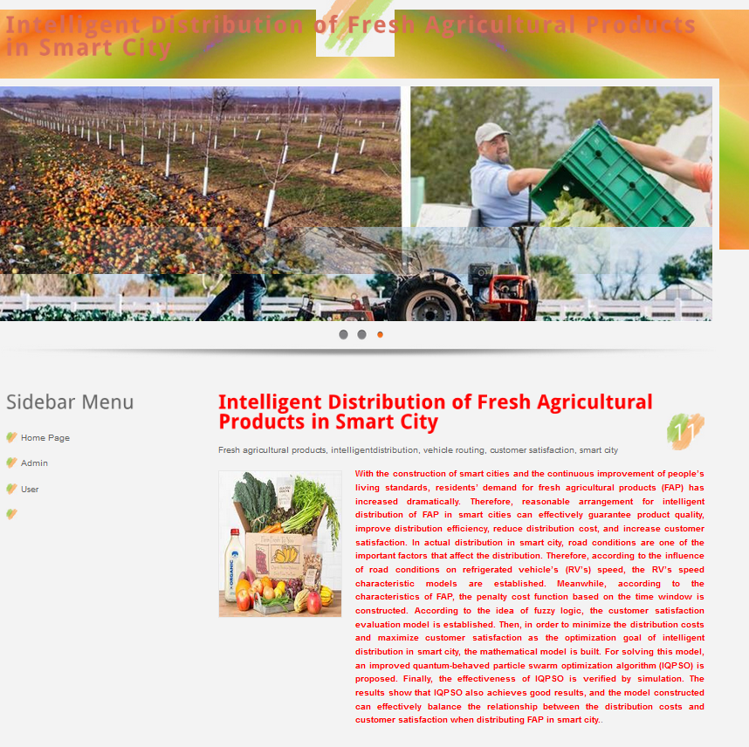
HOME PAGE

Slide 8
ADMIN OPTIONS

Slide 9
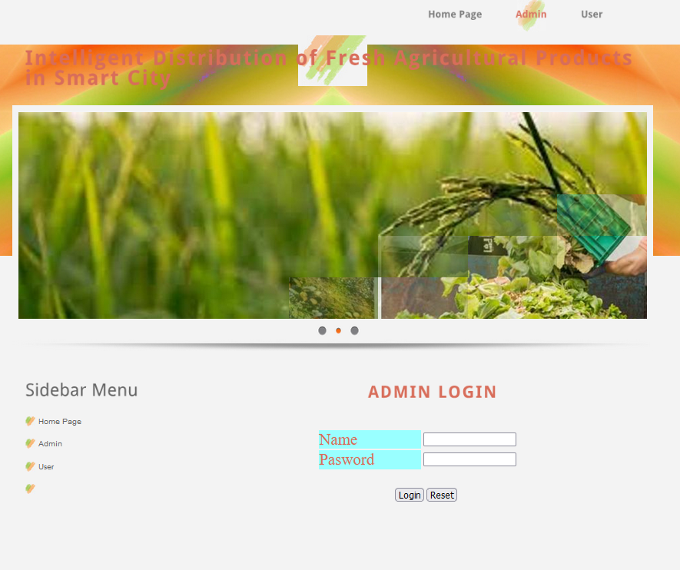

Slide 10
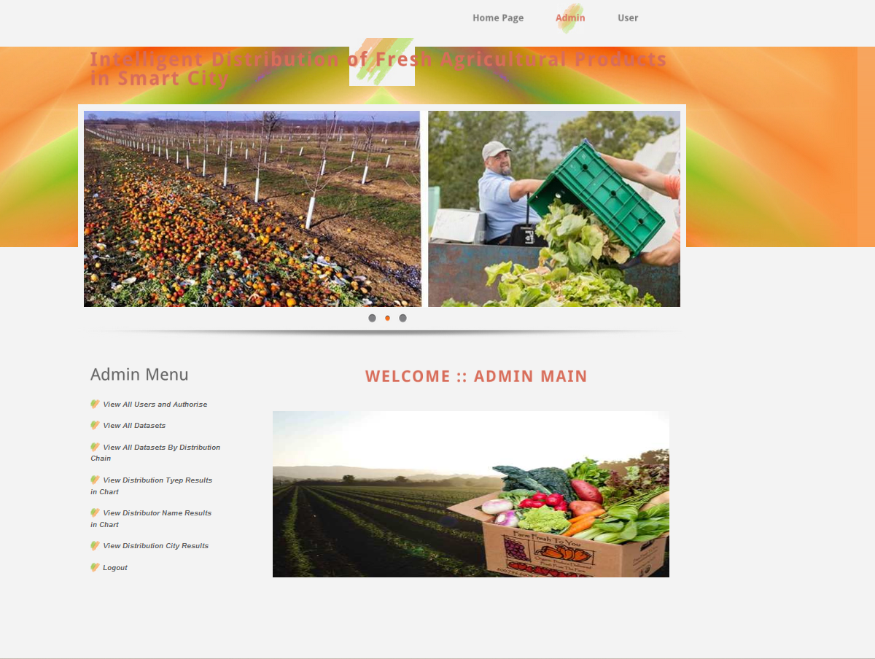

Slide 11
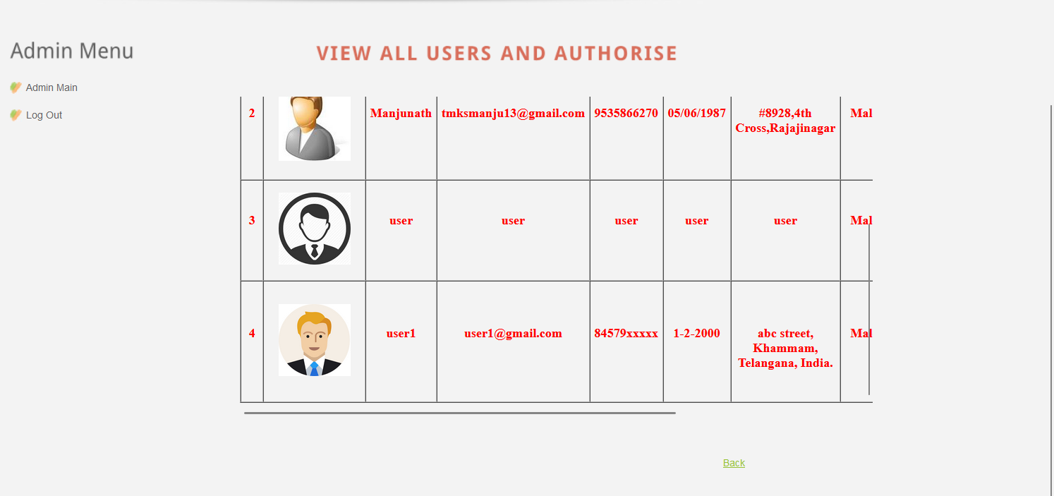

Slide 12
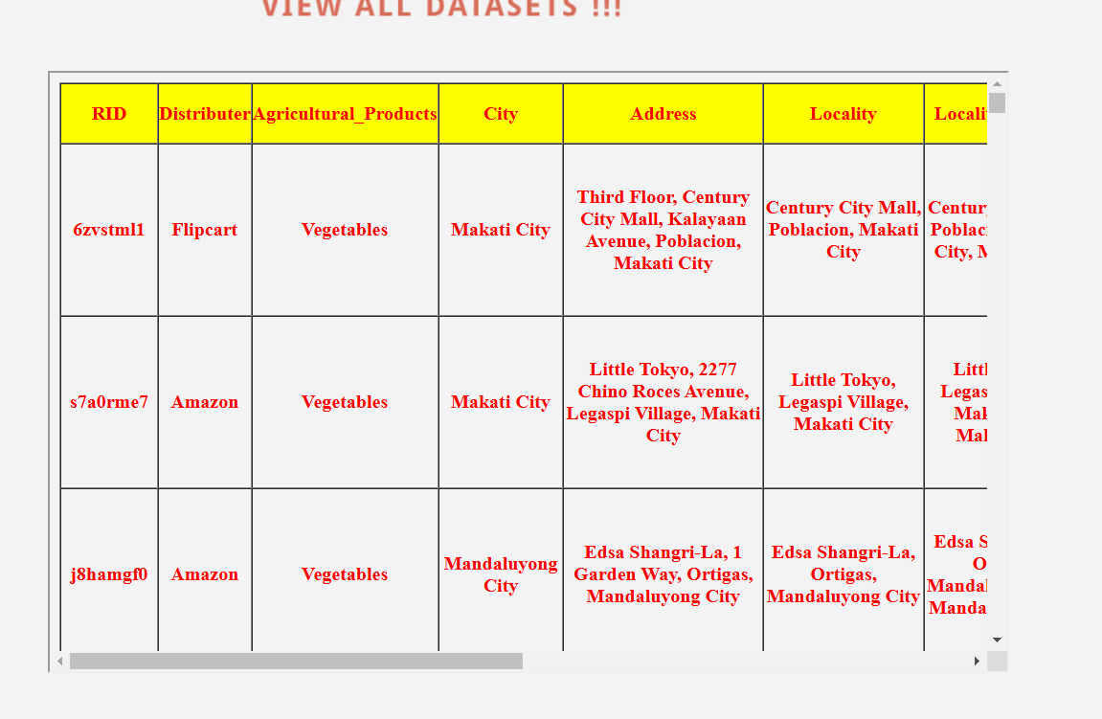

Slide 13
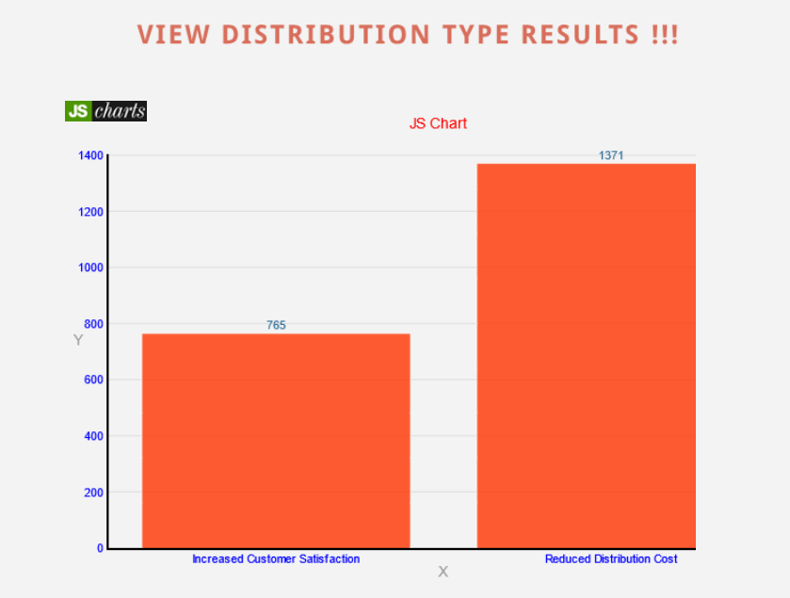
VIEW DISTRIBUTION TYPE RESULTS

Slide 14
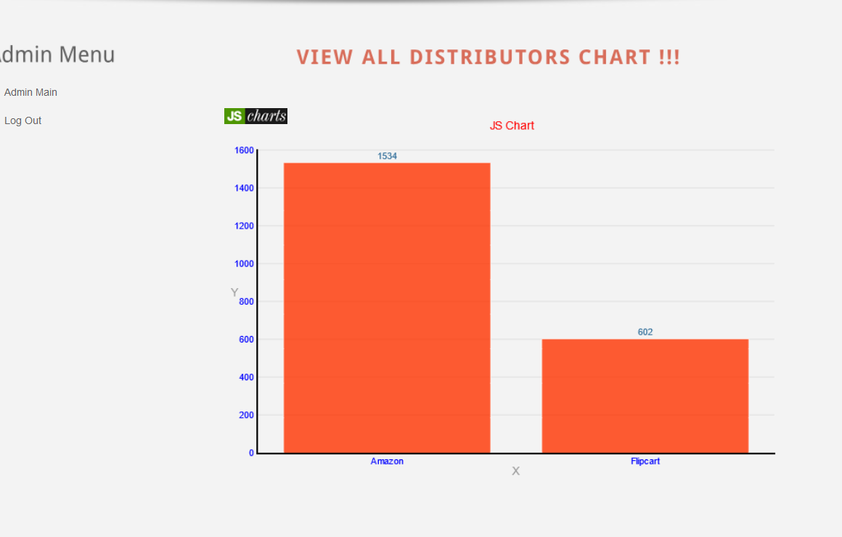
VIEW ALL DISTRIBUTOR NAME RESULTS

Slide 15
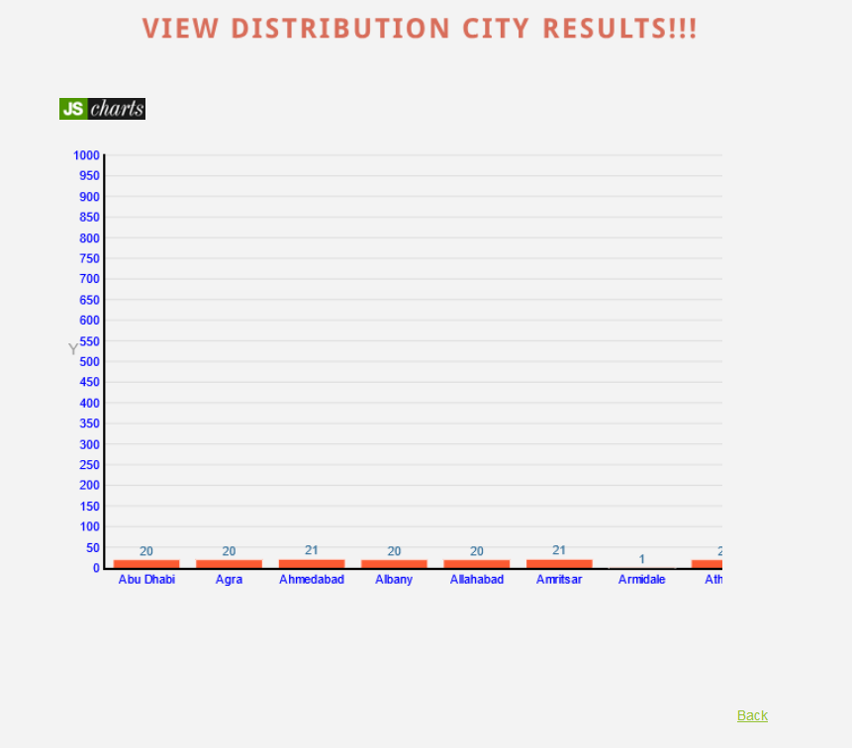
VIEW DISTRIBUTION CITY RESULTS

Slide 16
USER OPTIONS

Slide 17
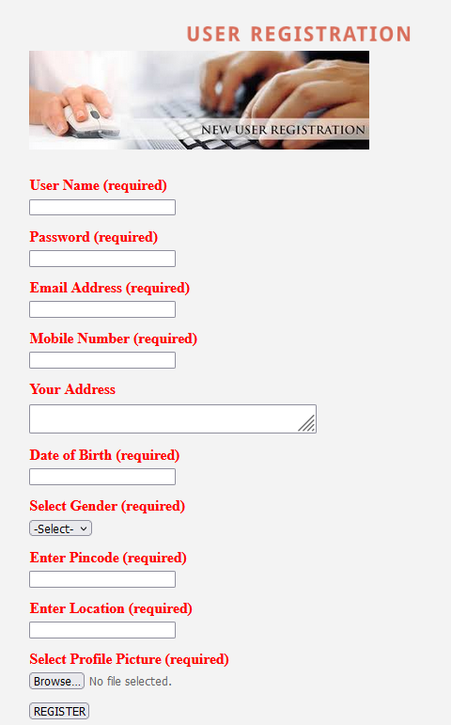
NEW USER REGISTRATION

Slide 18
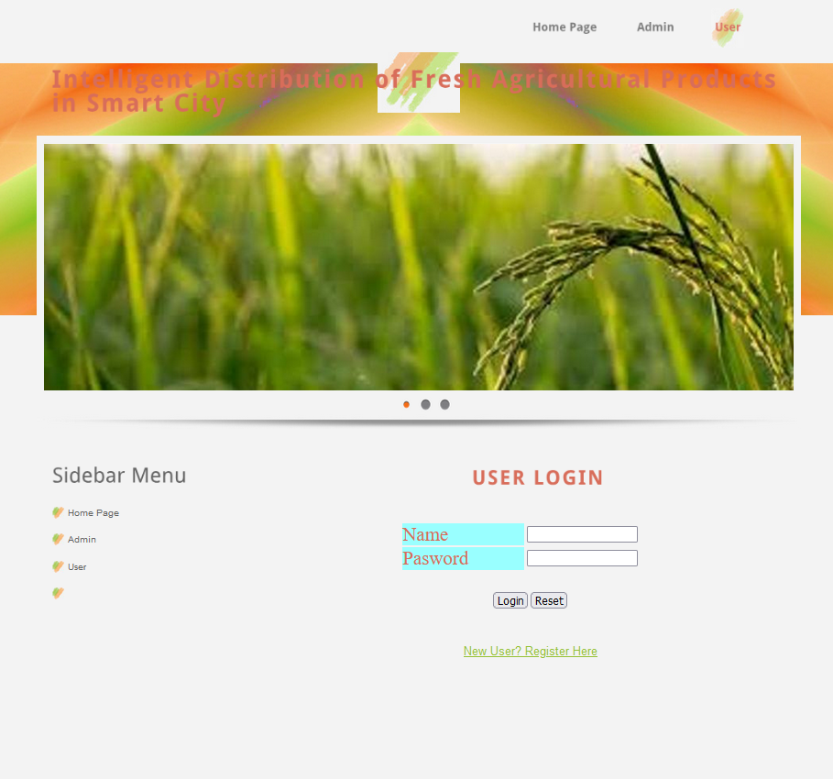

Slide 19
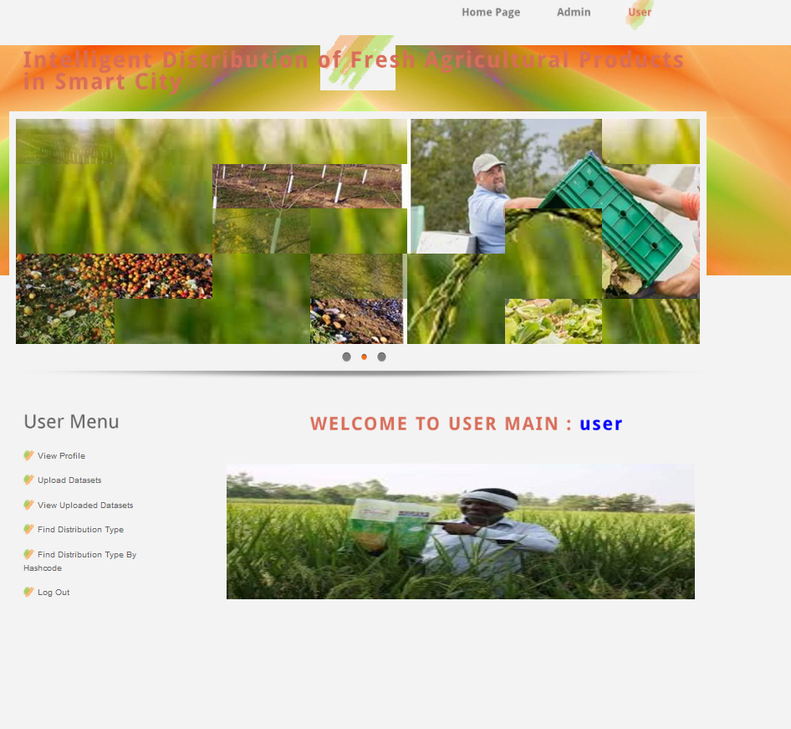

Slide 20
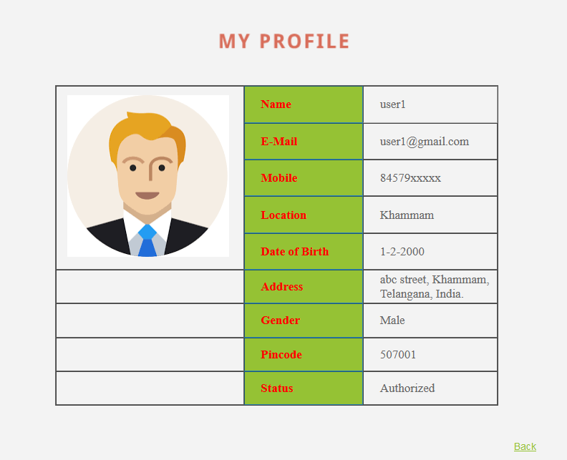

Slide 21


Slide 23
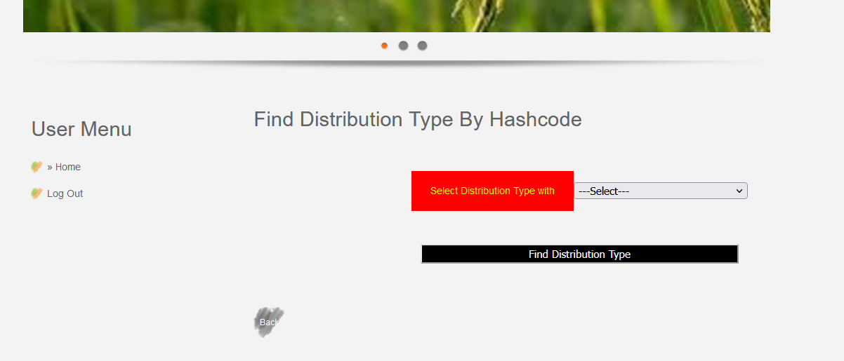
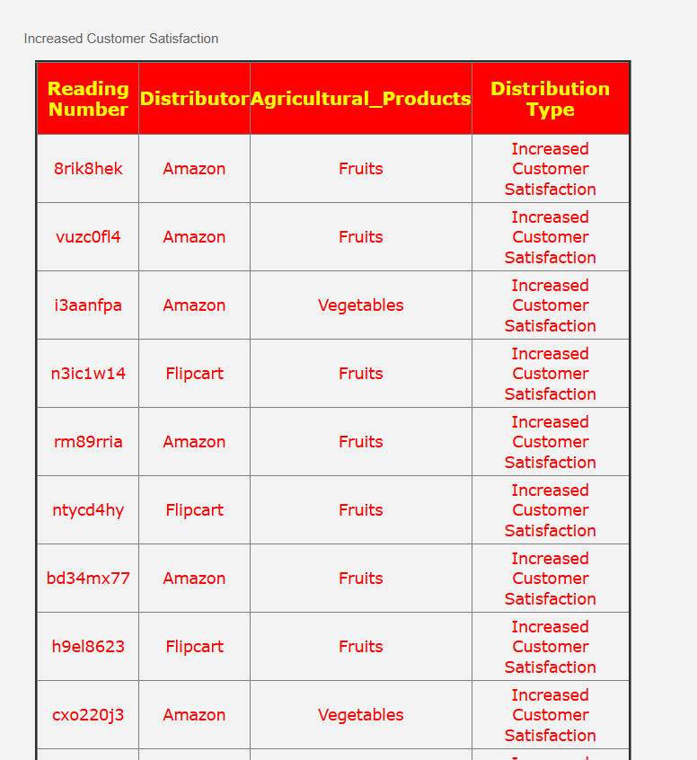
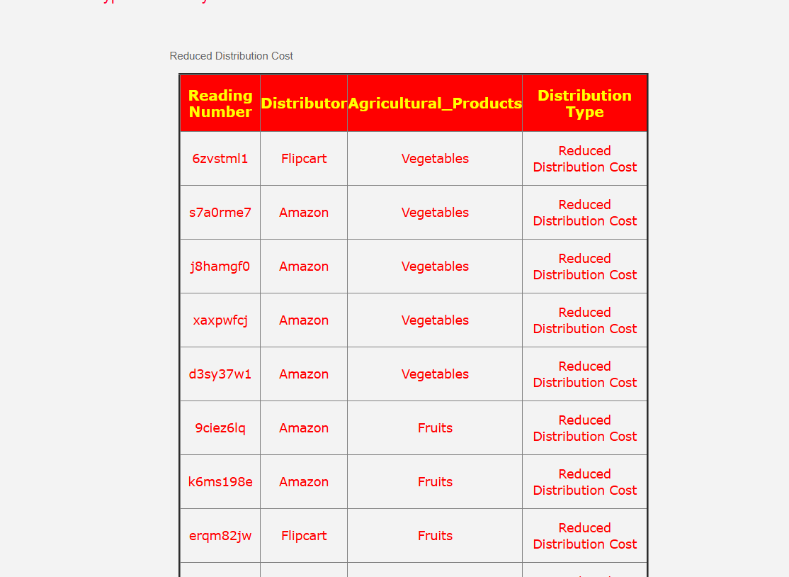

Slide 24
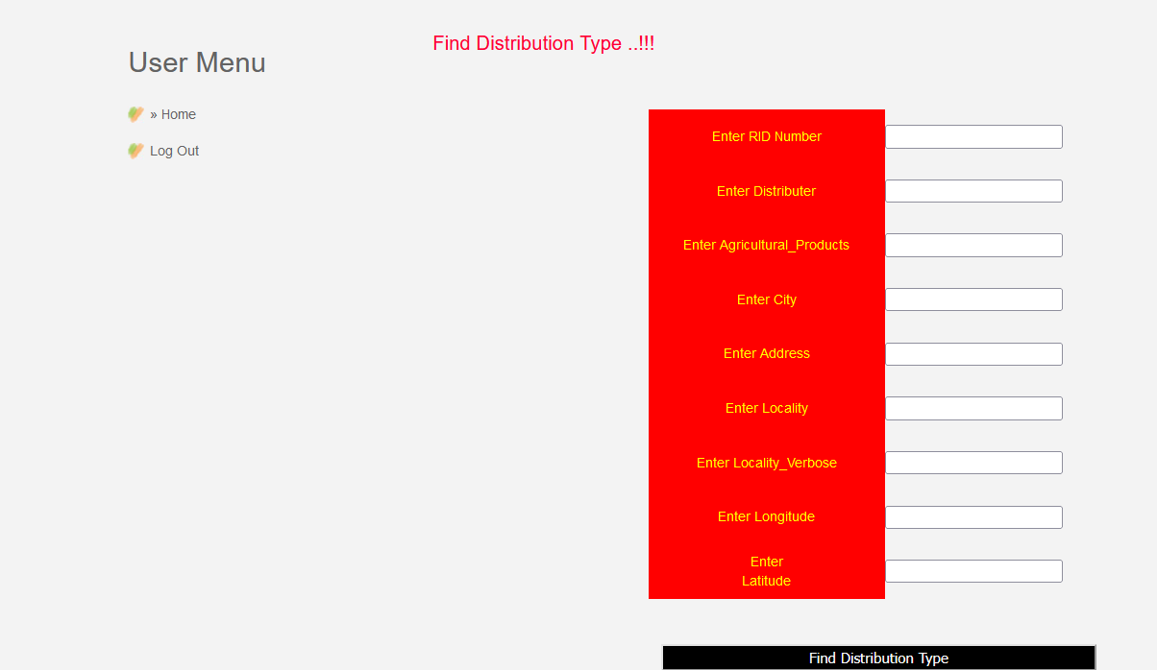
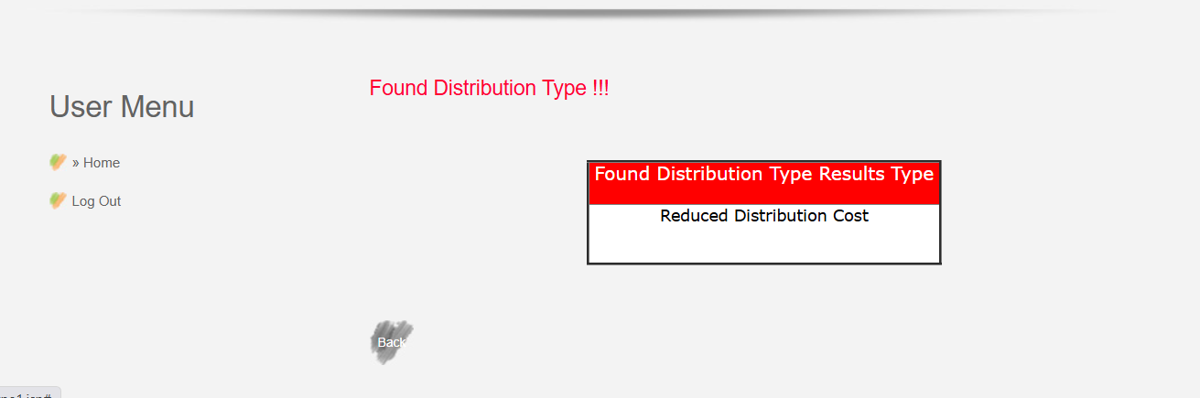

Slide 25
Challenges
Road Conditions: Impacts on distribution vehicle speed.
Customer Satisfaction Measurement: Often subjective and challenging to quantify.

Slide 26
Conclusion
Summary:
The project presents a viable model for FAP distribution in smart cities.
IQPSO is effective in optimizing cost and satisfaction.

